Slide 1
Proof Techniques
Part I/I

Slide 2
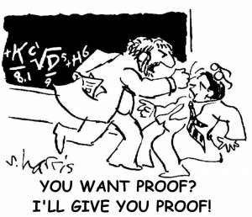
Outline
Proof techniques
direct
induction
contradiction

Slide 3
Proof Techniques
A valid proof is a valid argument, i.e. the conclusion follows from the given assumptions.
Proof by example:
The author gives only the case n = 2 and suggests that it contains most of the ideas of the general proof.
Proof by intimidation: 'Trivial.'
Proof by cumbersome notation: Best done with access to at least four alphabets and special symbols.
Proof by exhaustion: An issue or two of a journal devoted to your proof is useful.
Proof by omission: 'The reader may easily supply the details.' 'The other 253 cases are analogous.' '...‘
Proof by obfuscation: A long plotless sequence of true and/or meaningless syntactically related statements.
Proof by wishful citation: The author cites the negation, converse, or generalization of a theorem from literature to support his claims.
Three techniques:
Direct proof
Proof by induction
Proof by contradiction.

Slide 4
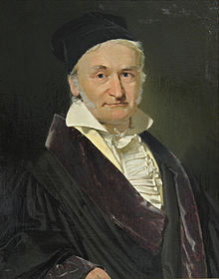
Proof Technique: Direct Proof
Prove that
Define
Note:
Sum up:
n+1 terms
Carl F. Gauss
(1777-1855)
n+1 terms
Thus:
3/11

Slide 5
Mathematical Induction
Prove propositions of the form: ∀n P(n)
The proof consists of two steps:
Basis Step: The proposition P(1) is shown to be true
Inductive Step:
Assume P(k) is true (when n=k), then, prove P(k+1) is true (when n=k+1).
When both steps are complete, we have proved that "∀n P(n)” is true
Notes:
For n natural number

Slide 6

Why Does it Work?
Analogy with climbing
Ladders.
From step 2: P(1) → P(2) by Universal Instantiation.
From step 1: P(1)
Applying modus ponen: P(2).
Repeat the process to get P(3),P(4),P(5), etc. So, all P(k) are true! i.e., ∀n P(n)
Inductive step
[P(1) ∧ ∀k(P(k)→P(k+1))] → ∀nP(n)
Basis
(valid argument)
Hypothesis

Slide 7
Example: Mathematical Induction
Prove that
Let P(n) denote
Basis step: P(1) is true
Inductive step. Assume P(k) true, k>0:
Prove P(k+1) true :
So, P(n) is true for n=k+1 and thus true for all n:
∀n P(n) is true
6/11

Slide 8
Complete Induction
Prove propositions of the form: ∀n P(n)
The proof consists of two steps:
Basis Step: The proposition P(1) is shown to be true
Inductive Step:
Assume, for k>1, P(m) is true for every m < k, then, prove P(k) is true.
When both steps are complete, we have proved that "∀n P(n)” is true

Slide 9
Example: Complete Induction
Prove that every natural number n>1 is either a prime, or a product of primes.
P(n)=“(n=1) V (n is prime) V (n can be factored into primes)”
Basis Step: P(1) is true because n=1
Inductive Step: Suppose k>1, and P(m) is true for all m<k.
We must show that P(k) is true.
If k is prime, then P(k) is true.
Otherwise, since k>1, we can factor k=pq, with p,q natural numbers <k.
The factor p is either prime or factors into prime, by induction hypothesis.
And the same is true for q.
Therefore k factors into primes.
8/11

Slide 10
Proof by Contradiction
We want to prove P(n) → Q(n)
Assume by contradiction that ⌐(P(n) → Q(n))
This happens exactly if P(n) and ⌐Q(n).
Suppose that P(n) and ⌐Q(n).
Prove that this gives a contradiction, namely
⌐(P(n) → Q(n)) → C Λ ⌐C
This is equivalent to P(n) → Q(n) (truth table!)

Slide 11
Proof by Contradiction: Example
Prove that: If n² is even, then n is even, for n integer.
Lets assume: n² is even but n is not even (P(n)=“n² is even ” and Q(n)=“n is even ”).
n is not even ⇔ n is odd, i.e., n = 2k+1, k integer.
Then n² = (2k+1)² = 4k² + 4k + 1 = 2 (2k² + 2k ) + 1 (odd)
This is a contradiction (C=“n² is even” , C Λ⌐C)
This concludes the proof!
10/11

Slide 12
Proof by Contrapositive
We want to prove P(n) → Q(n)
This is equivalent to prove that ⌐Q(n) → ⌐P(n)
Example: Prove that if n² is even, then n is even.
P(n)=“n² is even”, Q(n)=“n is even”
n is not even ⇔ n is odd, i.e., n = 2k+1, k integer.
Then n² = (2k+1)² = 4k² + 4k + 1 = 2 (2k² + 2k ) + 1 (odd)
This shows that ⌐P(n), and concludes the proof!

Slide 13
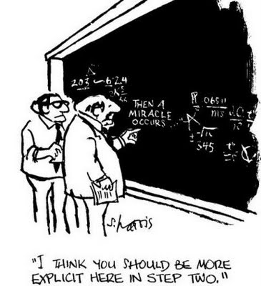
Summary
Generic proof techniques
Direct proof
Mathematical induction
Contradiction.

